Slide 1

Journey
Explore the way you want to
Luisa, Noah, Sudhi, Kyle
Notes:
Discover your ______
home
parks
vacation
shops
events
Journey

Slide 2
Journey
Explore DC
Personalized routes
Unique experiences
Notes:
(In the brief overview of the system, please briefly remind everyone of the motivation and context for your project.)

Slide 3
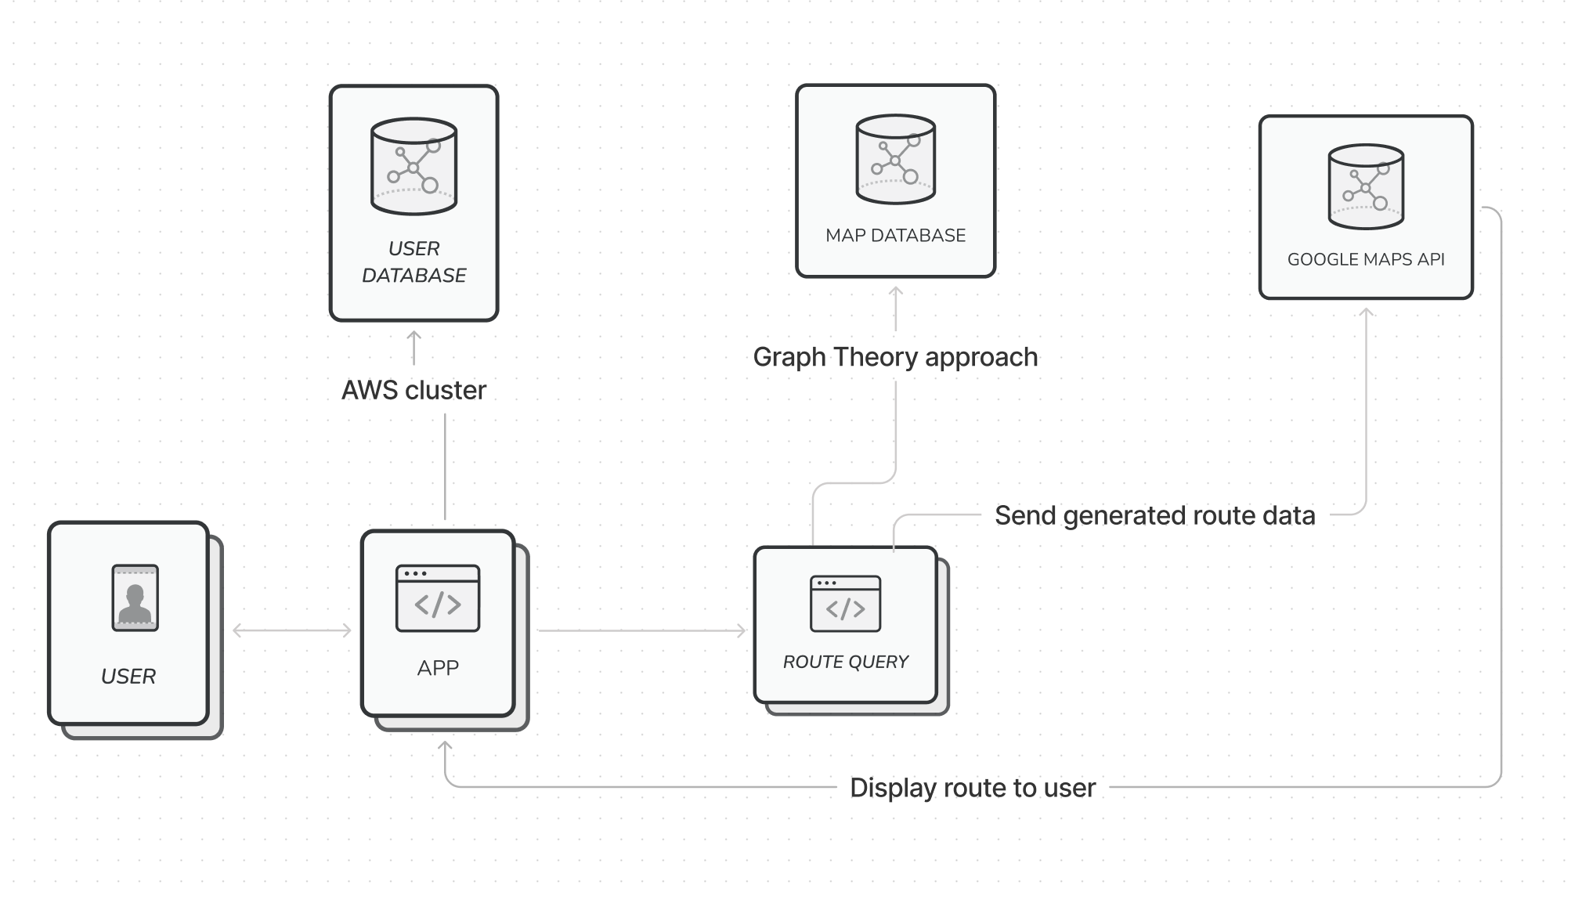
System architecture diagram
Notes:
Provide the system architecture diagram

Slide 4


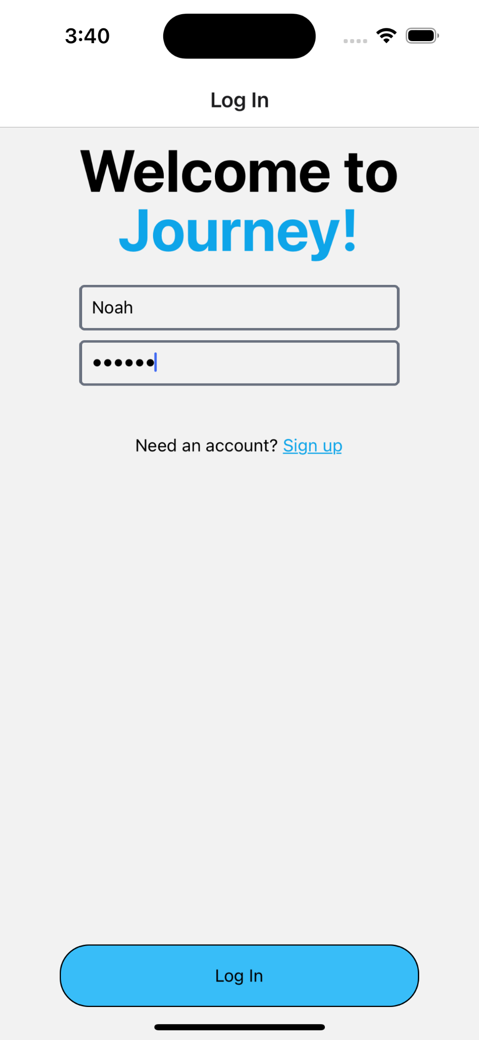
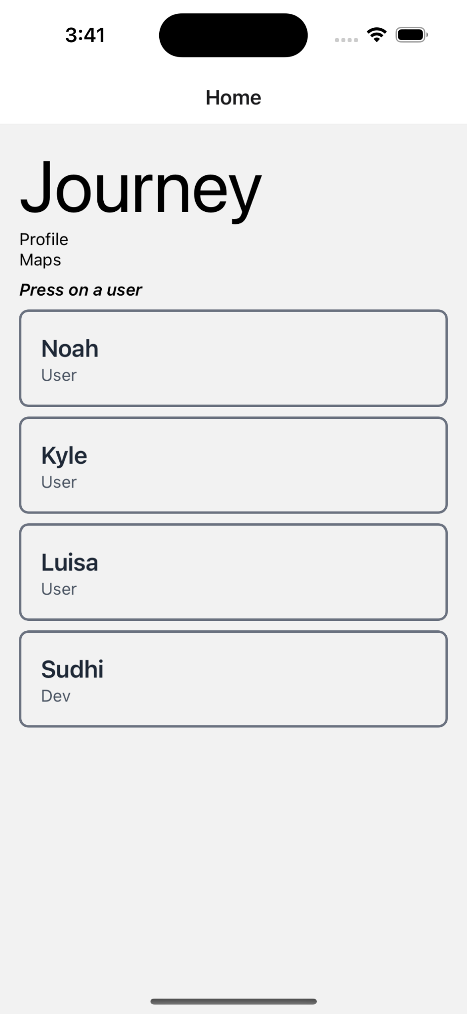
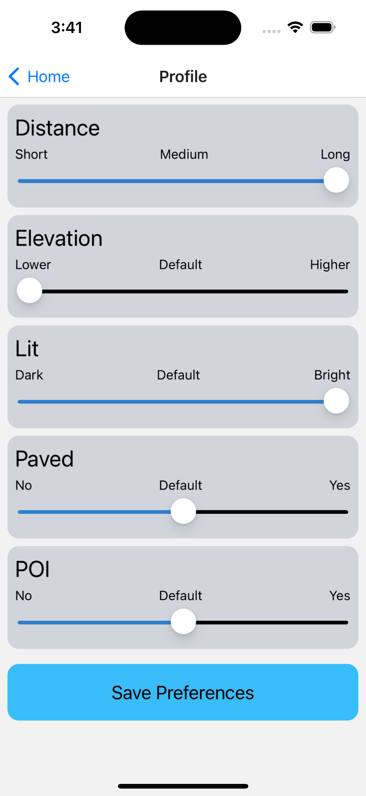
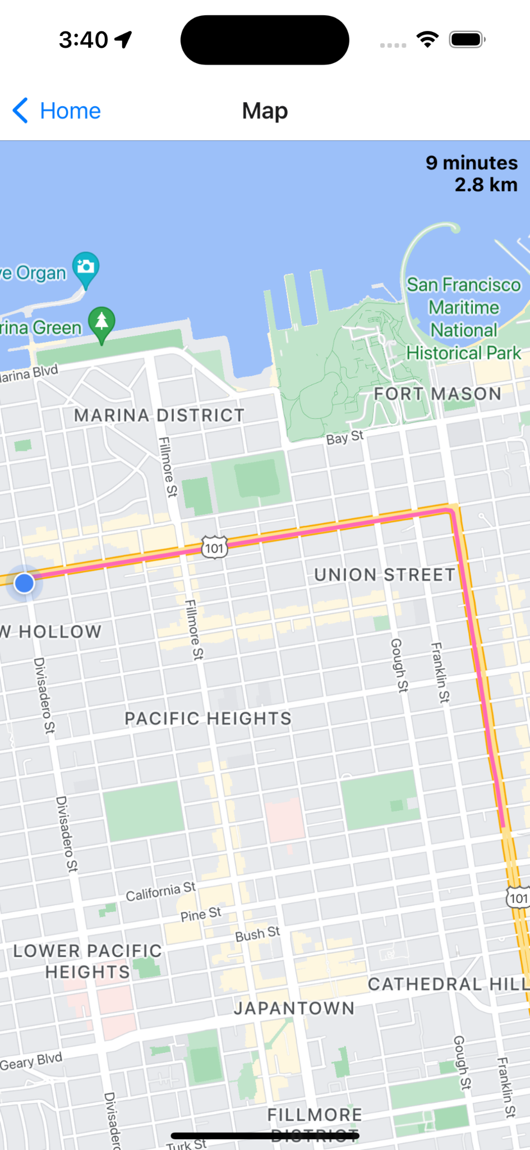
User Interface and Experience
Primary Goal: Users to be able to easily and effectively use our app

Slide 5
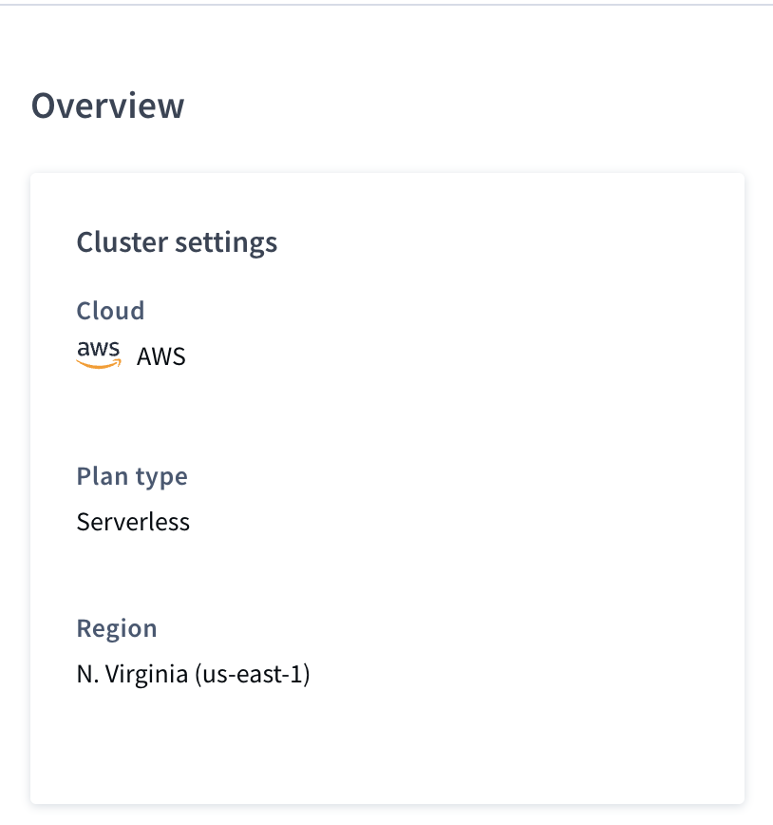
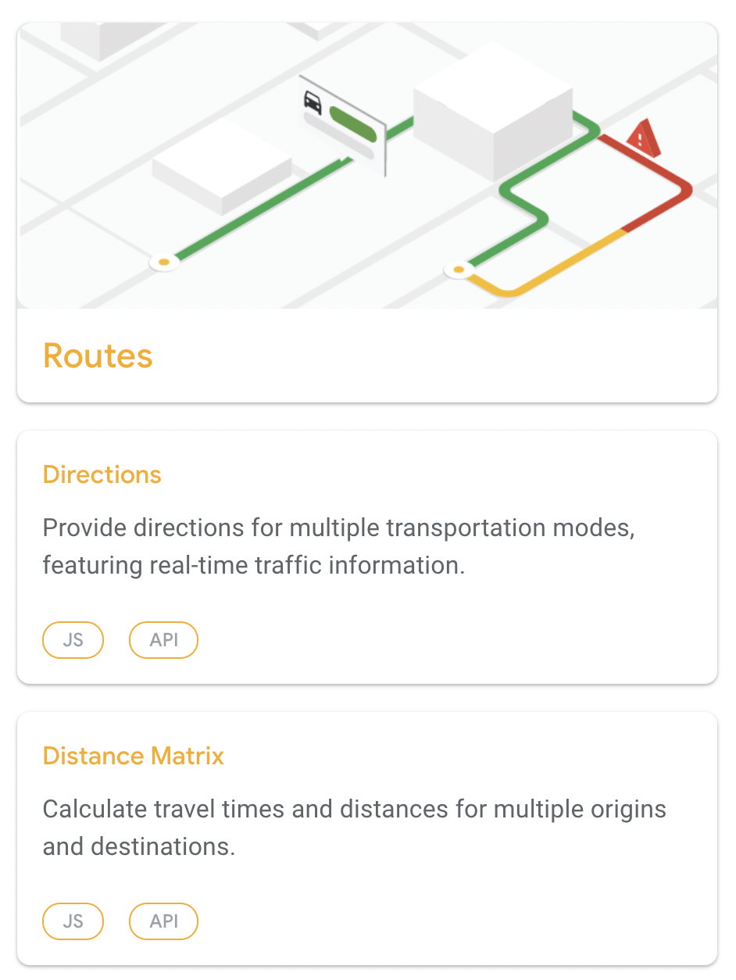
App development
Set up React Native
Connected user database
Integrated front end routing display

Slide 6
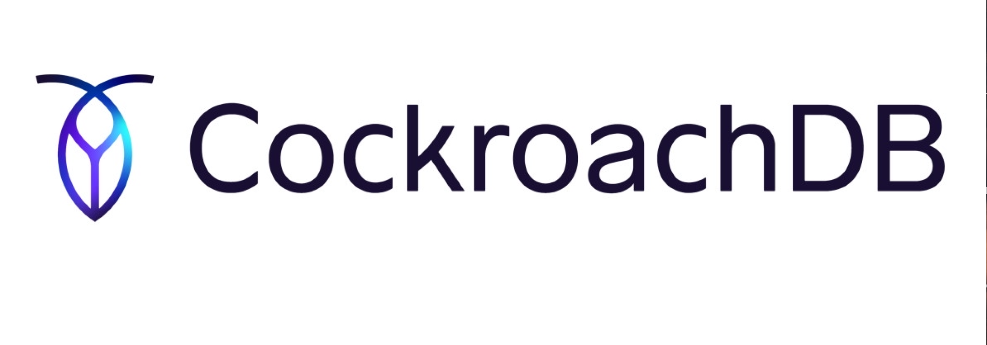

Data Acquisition and Security
Database
CockroachDB serverless option
Hosted on AWS
Encryption
At Flight
At Rest
Notes:
Transferred
We are using AWS as the environment where our tools and systems will run
CockroachDB will be its own system that will interact with other systems also hosted in AWS.
automatically receive this protection using cloud provider-managed keys
Network traffic in CockroachDB, between nodes as well as from clients to nodes, is encrypted with Transport Layer Security (TLS).
TLS can establish securely authenticated and encrypted traffic between a client (the party who initiates the session) and a server (the party receiving the connection request).
So CockroachDB can be deployed on AWS. We actually have an offering CockroachDB serverless that is free up to 5GB. If you have more data or need more credits, you can purchase through a credit card.
When you select CockroachDB serverless, it will ask if you'd like for it to be hosted on AWS or GCP.
I think that would be the best solution for starting off as it's the quickest and easiest way to get started.
So AWS will basically be the environment where your tools and systems run. So CockroachDB will be it's own system that is hosted in AWS, but you can have it interact with other systems also hosted on AWS.
CockroachDB Transport Layer Security (TLS)
At Rest: AWS encryption using cloud provider-managed keys

Slide 7
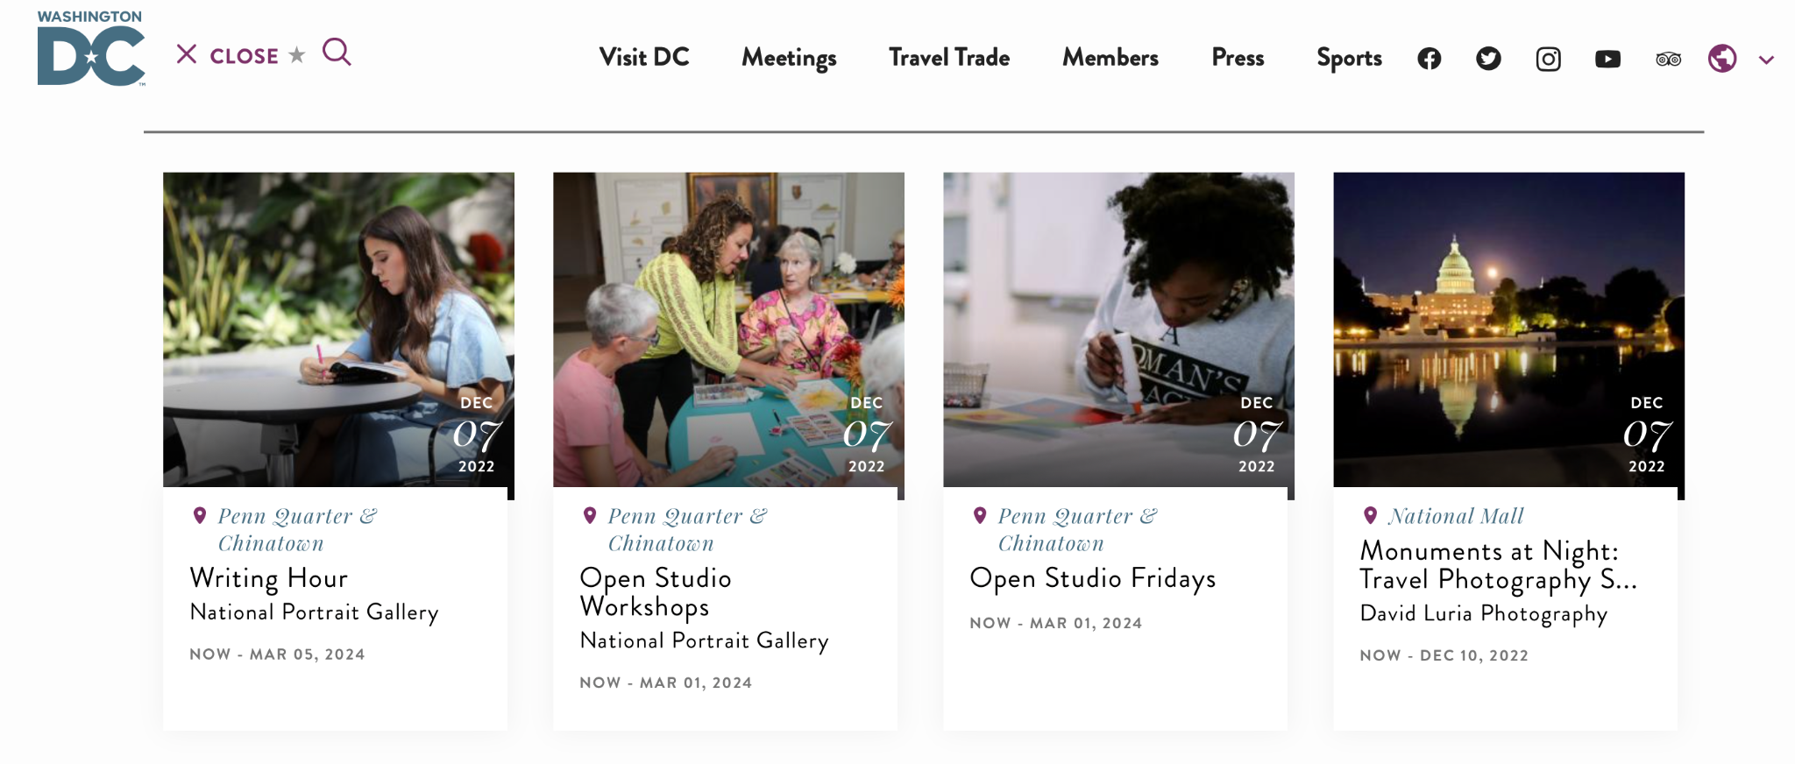
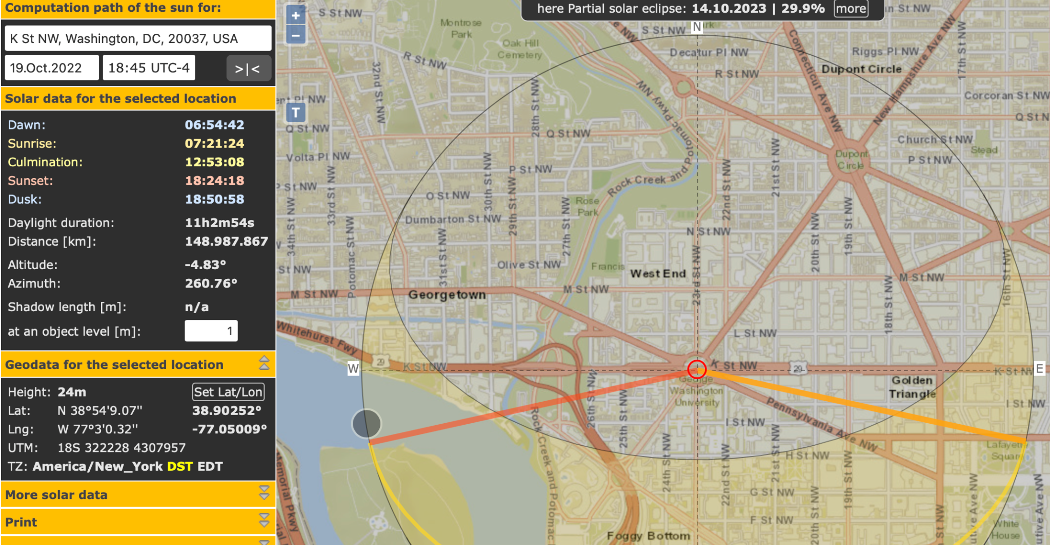
Data Acquisition and Security
Shade: SunCalc API
Events Recommendations:
Notes:
W information scraped from the internet
For those who have a shade preference we have a shading algorithm which uses
Before the users decide on where to walk to We provide users with event recommendations which we get from scraping websites
Suncalc API to help us calculate shade
SunCalc shows the movement of the sun and sunlight-phase for a certain day at a certain place.
r.s

Slide 8
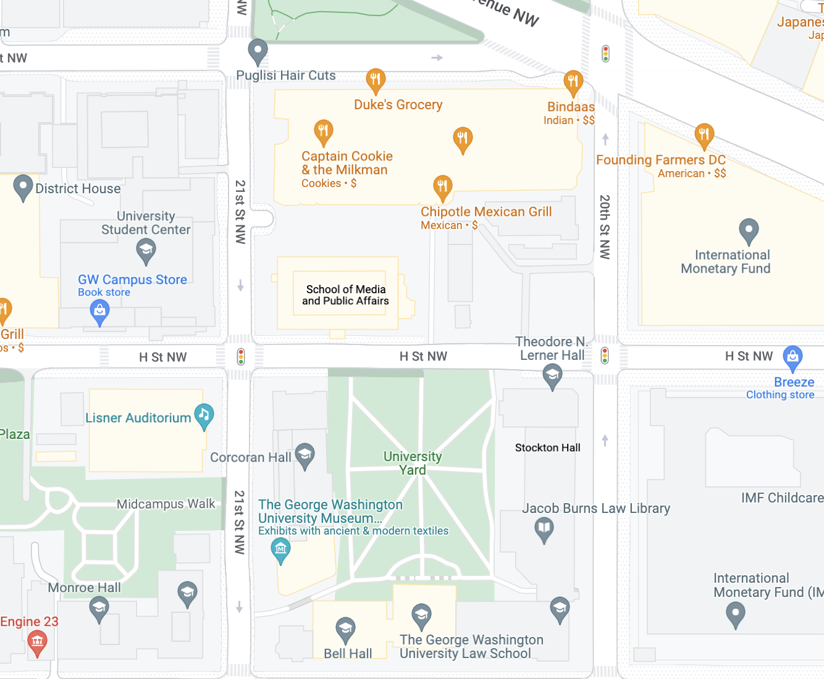
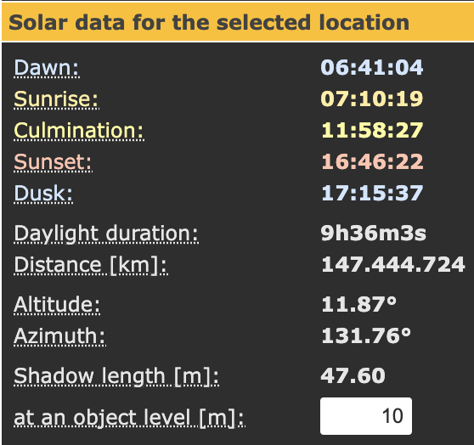
Shading Algorithm
Notes:
send s in the lat and log of For shading we receive lat and long of a point in the possible path from the routing algorithm
From there we calculate the angle at which the sun is hitting using the api since we know that the shade will come in at that angle
We do this because it is the angle at which the shadows will hit the point
Then we compute down this line to see if there are any

Slide 9
Shading Algorithm
Notes:
Places API for Google Maps which has features like place details which we will use to retrieve details about a location
Open source LiDAR map for elevation
For shade suncalc?
GRASS GIS, is a Geographic Information System (GIS) used for geospatial data management and analysis, image processing, graphics/maps production, spatial modeling, and visualization.
SunCalc shows the movement of the sun and sunlight-phase for a certain day at a certain place.
r.sun - Solar irradiance and irradiation model.
Computes direct (beam), diffuse and reflected solar irradiation raster maps for given day, latitude, surface and atmospheric conditions. Solar parameters (e.g. sunrise, sunset times, declination, extraterrestrial irradiance, daylight length) are saved in the map history file. Alternatively, a local time can be specified to compute solar incidence angle and/or irradiance raster maps. The shadowing effect of the topography is optionally incorporated.
encryption

Slide 10
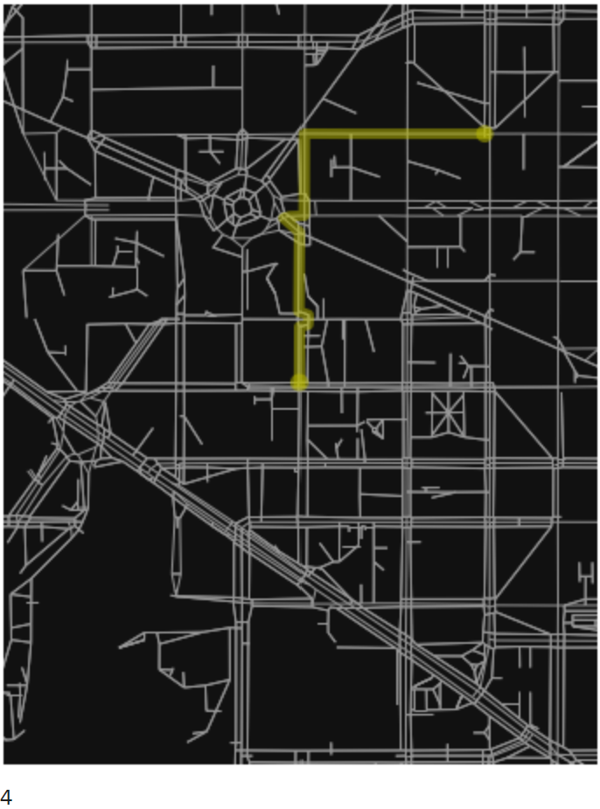
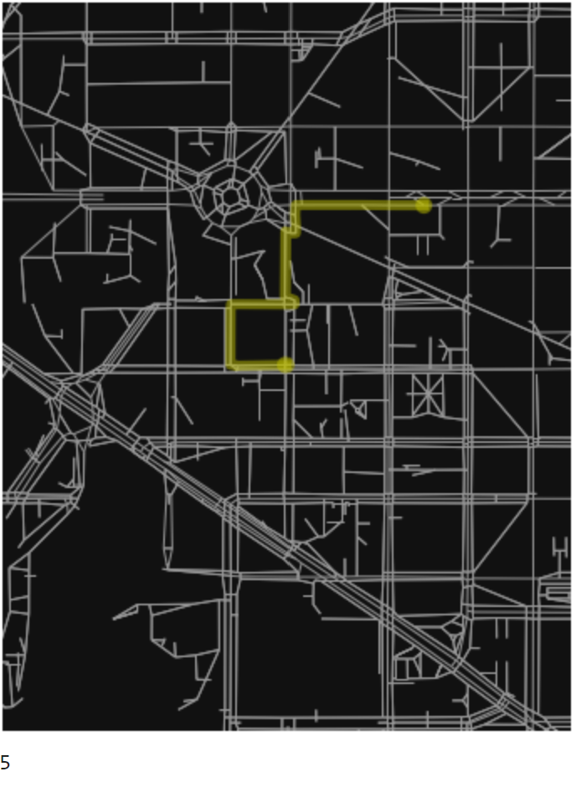
Routing
Personalized scoring
Route comparison
Route generation
Notes:
Read paper here

Slide 11
Beta prototype
Component Communication Host restful API Incorporate additional Google APIs | User Interface Survey Style Feedback Finalize walking view
Data Collection Add tree shading More complete maps data | Routing Additional preferences Circular routing
Notes:
alpha prototype (plan for 1 minute max on this)

Slide 12
Any Questions?

